Slide 1
Ram Prasad
HR Analytics Dashboard
Introduction
Objective:
Develop an interactive HR Analytics Dashboard to analyze and visualize workforce metrics.
Enable data-driven decision-making by providing insights into employee attrition, demographics, and other key HR indicators.
Technologies Used
Tools and Technologies:
MS Excel: Data processing and visualization.
Pivot Tables: Dynamic data summaries.
Excel Formulas: Complex mathematical calculations.
Slicers: Interactive data filtering.
KPIs: Key performance indicators for quick insights.

Slide 2
Data Preparation
Data Import:
Imported raw HR data from MS Excel.
Data Cleaning:
Removed duplicates, handled missing values, and corrected inconsistencies.
Data Processing:
Organized and categorized data for effective analysis (e.g., by department, job role).
Dashboard Implementation
Interactive Visualizations:
Created bar charts, line graphs, and pie charts for key HR metrics.
KPI Cards:
Developed KPI cards to display total employees, attrition rate, and average age.
Slicers:
Added slicers for filtering data by gender, education field, and department.
Pivot Tables:
Used pivot tables to create dynamic summaries linked to visual elements.
Formula-Based Calculations:
Performed complex calculations (e.g., attrition rate, average age) using Excel formulas.

Slide 3





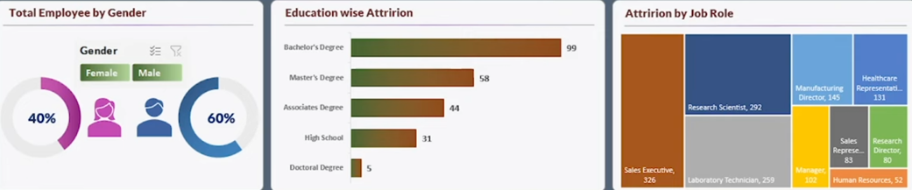
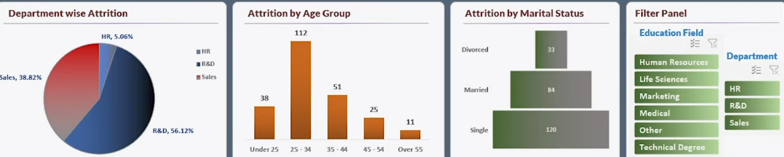
Key Metrics and Visualizations
Total Employees
Attrition Rate
Employee Demographics
Education-Wise Attrition
Department-Wise Analysis

Slide 4
Learning and Takeaways
Technical Skills:
Advanced expertise in Excel (pivot tables, slicers, formulas).
Analytical Skills:
Deepened understanding of HR metrics and their implications.
Presentation Skills:
Ability to present complex data in a clear, actionable format.
Conclusion
The HR Analytics Dashboard significantly improved the HR team’s ability to monitor and analyze key metrics. The dashboard's interactive nature allowed for a detailed examination of various factors influencing employee attrition, enabling the HR team to identify trends and take proactive measures.
The dashboard facilitated data-driven decision-making, helping the organization to better understand its workforce dynamics and implement strategies to reduce attrition and improve employee satisfaction.

Slide 5
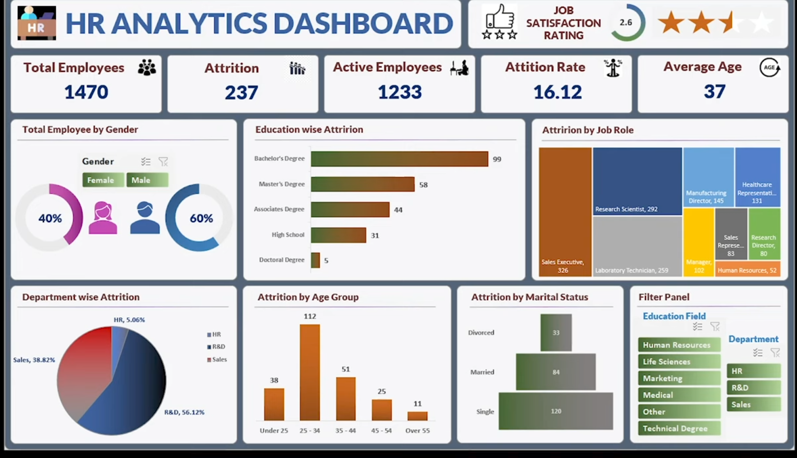

Slide 6
GitHub Link: https://github.com/ram0109/HR-Analytics-Dashboard
Thankyou for your Attention!
Ram Prasad

